Slide 2
.NET Workshop
Speaker’s :
Vladislav Antonyuk
Rostyslav Skrypnyk

Slide 3

AI-Friendly Calendar!

Slide 4
What Is Software Architecture?
It is a decision about the overall structure and behavior of the system.
These are decisions that are expensive to change.
Monoliths
Microservices
Monolithic Architecture
Microservices Architecture
One unit to deploy
Lots of blocks to deploy
User Interface
Microservice UI
Microservice
Use method call to communicate
Use network call to communicate
Business Layer
Data Interface
Microservice
Microservice
Microservice
Scalable, but less efficient use of resources
Horizontally and vertically scalable
Provide immediate consistency
Provide gradual consistency

Slide 5
Advantages of Microservices
Scalability Data isolation Autonomy of the organization Independent Deployment Limitations of the area of influence of errors

Slide 6
Microservices First?
It is difficult to define the boundaries of services. Boundaries are more difficult to change in a distributed system.
You shouldn't start a new project with microservices, even if you're sure your application will be big enough to justify it.
Martin Fowler

Slide 7
Advantages of Monoliths
Simplified deployment
Easier transaction management
Reduced complexity compared to microservices

Slide 8


Who Uses Monoliths?
Stack Overflow
Shopify

Slide 9
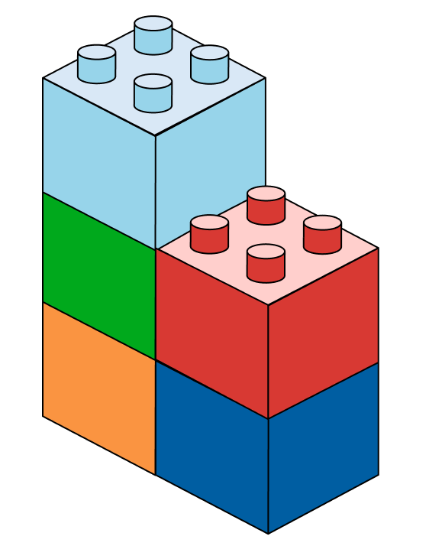
Modular Monolith
This is an approach to software design where a monolith is built with a focus on replaceable (and potentially reusable) modules
This is an architectural pattern that structures the application into independent modules (components) with clearly defined boundaries

Slide 10
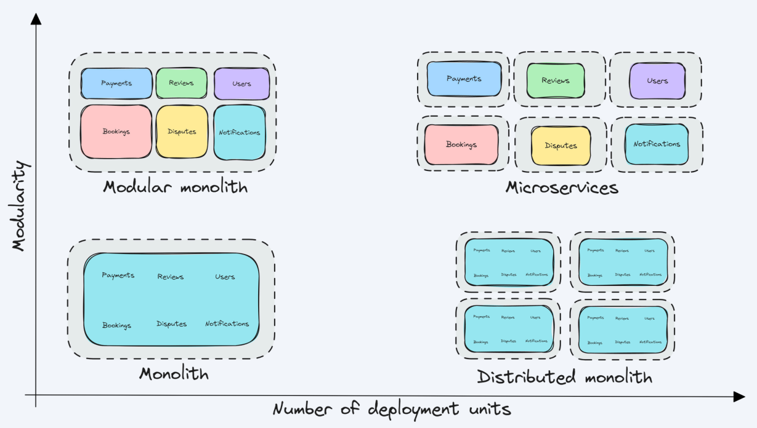
Modular Architecture

Slide 11
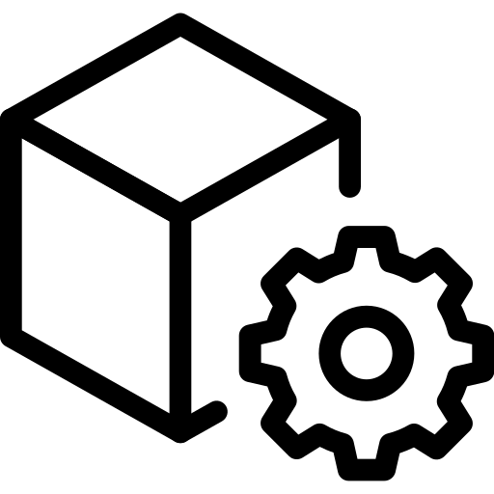
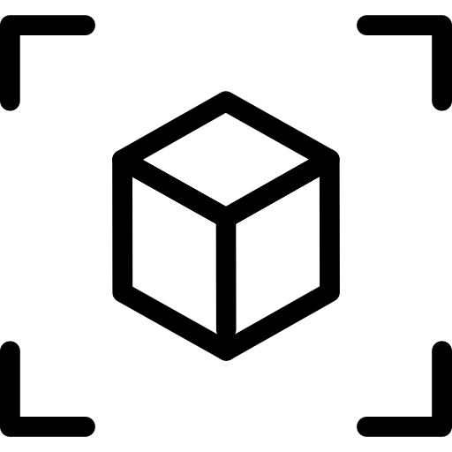
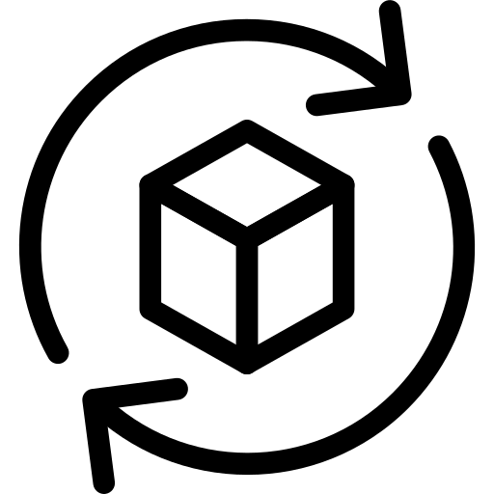
What Is a Module?
Modules represent cohesive sets of functionality
Each module can be considered as a separate application
Modules must be self-contained

Slide 12


Modular Monolith
Modular Monolith
API
Module A
Module B
Module C
Module D
Module E
Single Deployment

Slide 13
Advantages of a Modular Monolith
High cohesion → everything in the module serves one clear purpose.
Loose coupling → modules are independent and interact via interfaces or clean APIs.
Simplified deployment Improved performance Easier transition to microservices
Notes:
Cohesion = How focused a module/class is on a single task.
Coupling = How much one module/class depends on others.

Slide 14

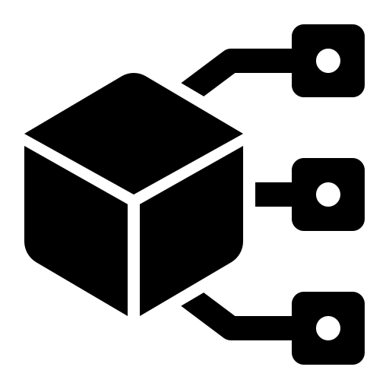

Modular Architecture
To achieve a modular architecture, modules must:
be independent and variable
provide the necessary functionality
have a well-defined interface for other modules

Slide 15
Limitations of Modules
Modules must comply with the following restrictions:
Logical isolation between modules Modules must communicate via a public API
Method calls: fast, in-memory Messaging: For weaker binding
Module data must be isolated in the database
Separate tables Separate schemas Separate databases Various databases

Slide 16
What If You Need Data From Another Module?
Use direct calls via public API
Use messaging
Copy data

Slide 17
Templates
https://www.nuget.org/packages/VladislavAntonyuk.DotNetTemplates

Slide 18
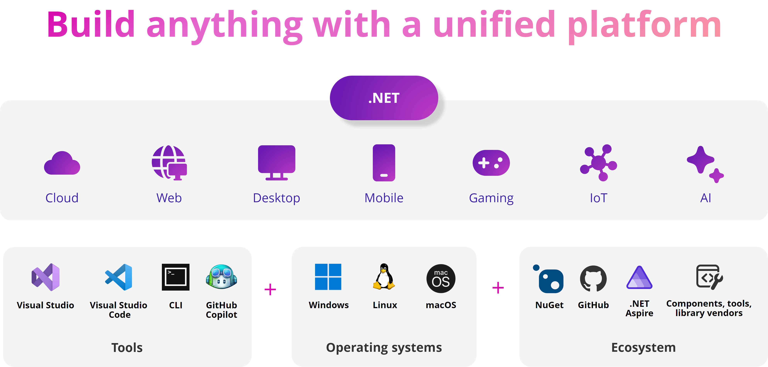
Overview of New .NET 9
https://devblogs.microsoft.com/dotnet/announcing-dotnet-9/

Slide 19
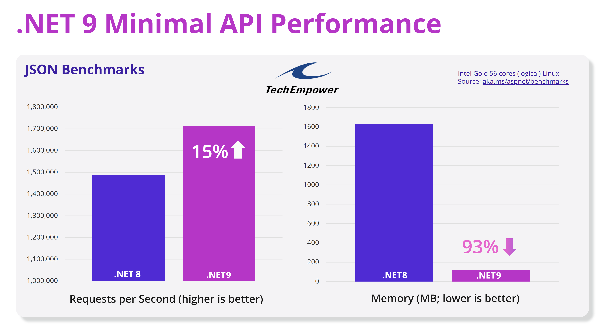
Overview of New .NET 9
https://devblogs.microsoft.com/dotnet/performance-improvements-in-net-9/

Slide 20
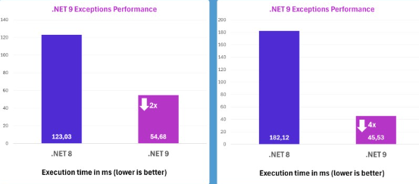
Overview of New .NET 9
Performance improvements in Exceptions

Slide 21
Overview of New .NET 9
New HybridCache
L1 Cache
IMemoryCache
L1 & L2 Cache
App’s memory
HybridCache
L2 Cache
+ Stampede Protection
+ Configurable Serialization
IDistributedCache
Redis
SQL
NCache

Slide 22
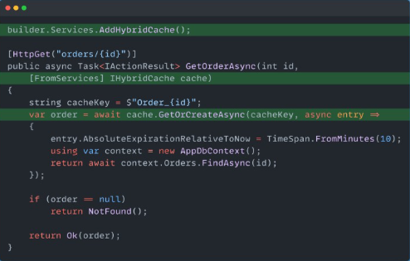
Overview of New .NET 9
New HybridCache

Slide 23
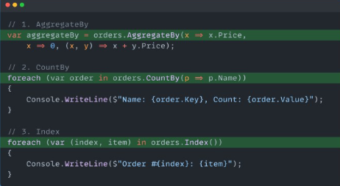
Overview of New .NET 9
New LINQ methods

Slide 24
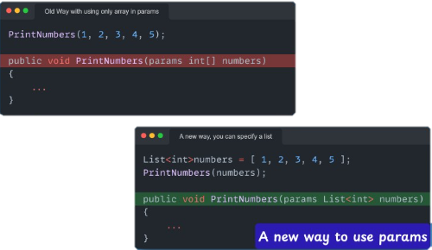
Overview of New .NET 9
C# 13 Params Collection

Slide 25
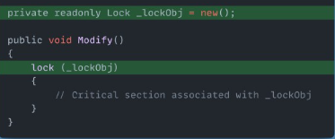
Overview of New .NET 9
C# 13 New Lock Class

Slide 26
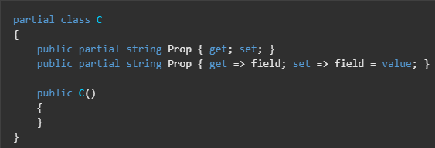
Overview of New .NET 9
C# 13 Partial Properties

Slide 27
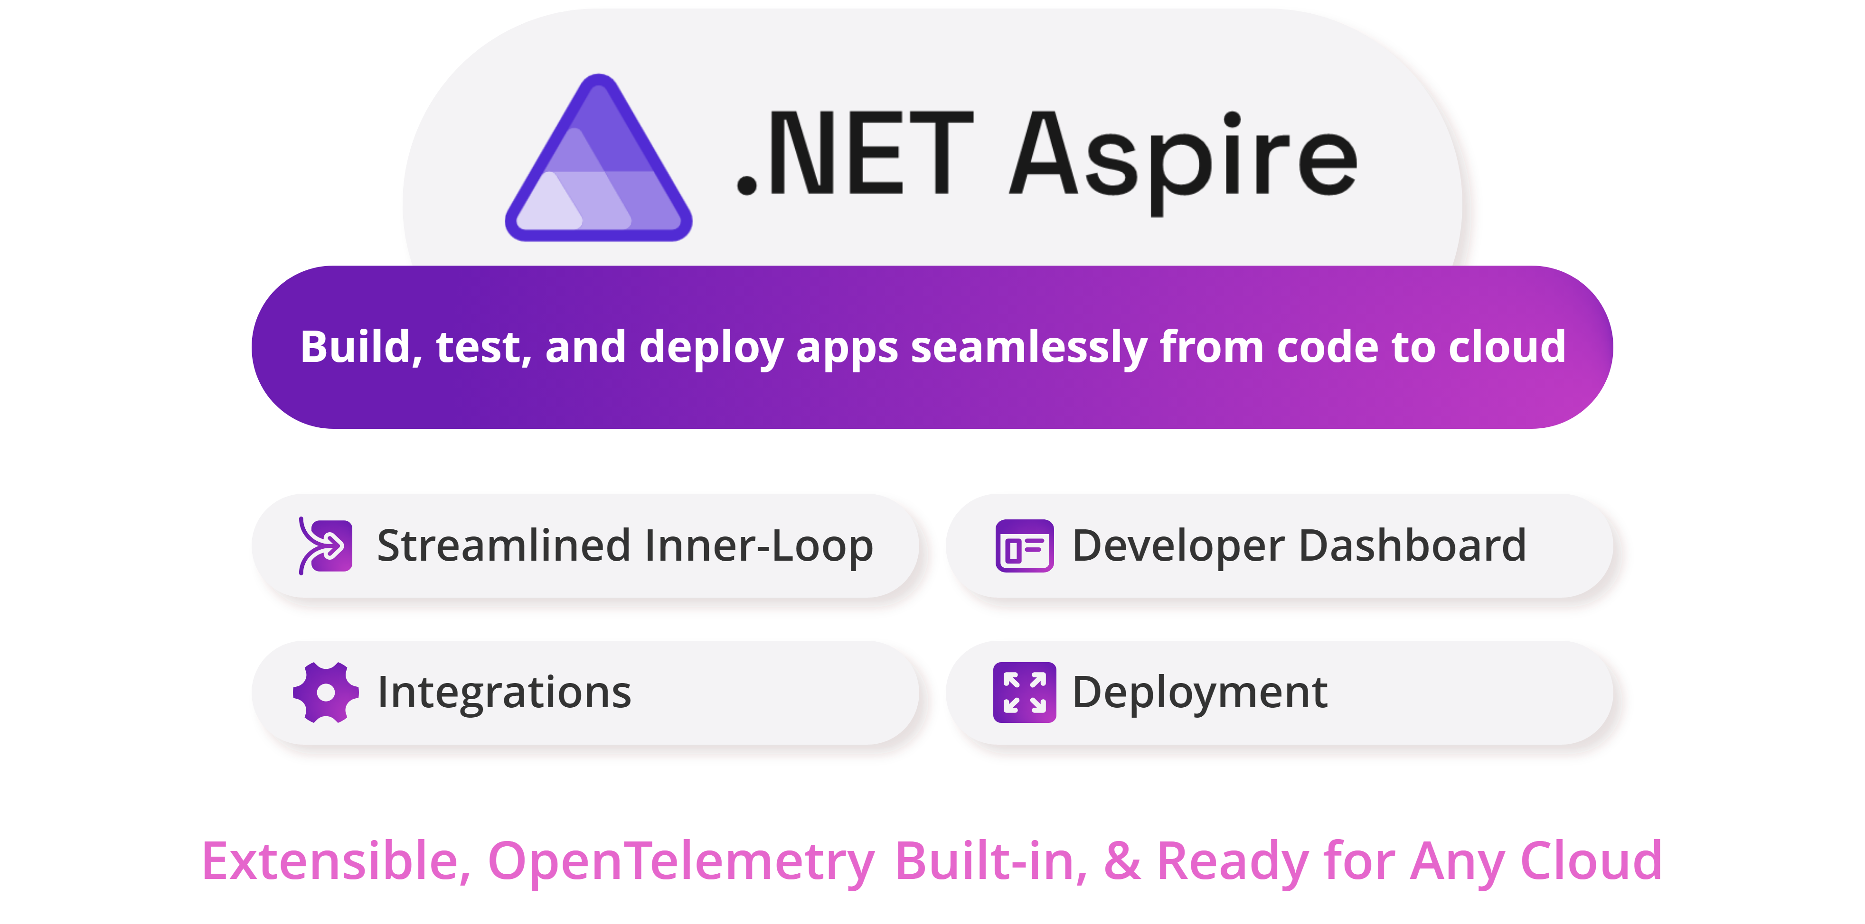
Overview of .NET ASPIRE

Slide 28
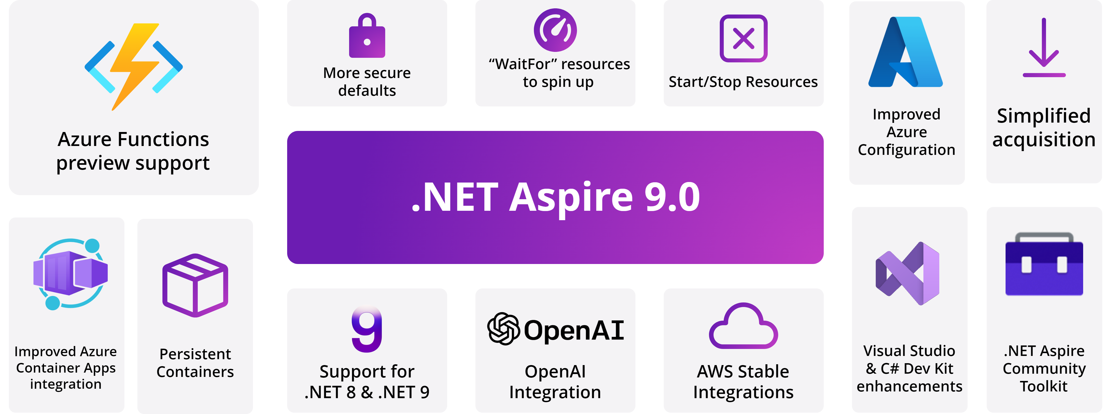
Overview of .NET ASPIRE

Slide 29
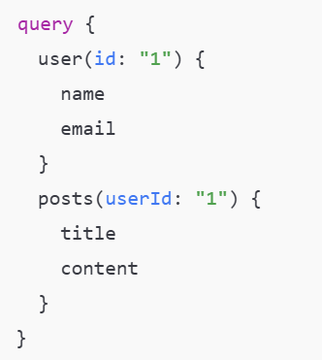
GraphQL and .NET

Slide 30
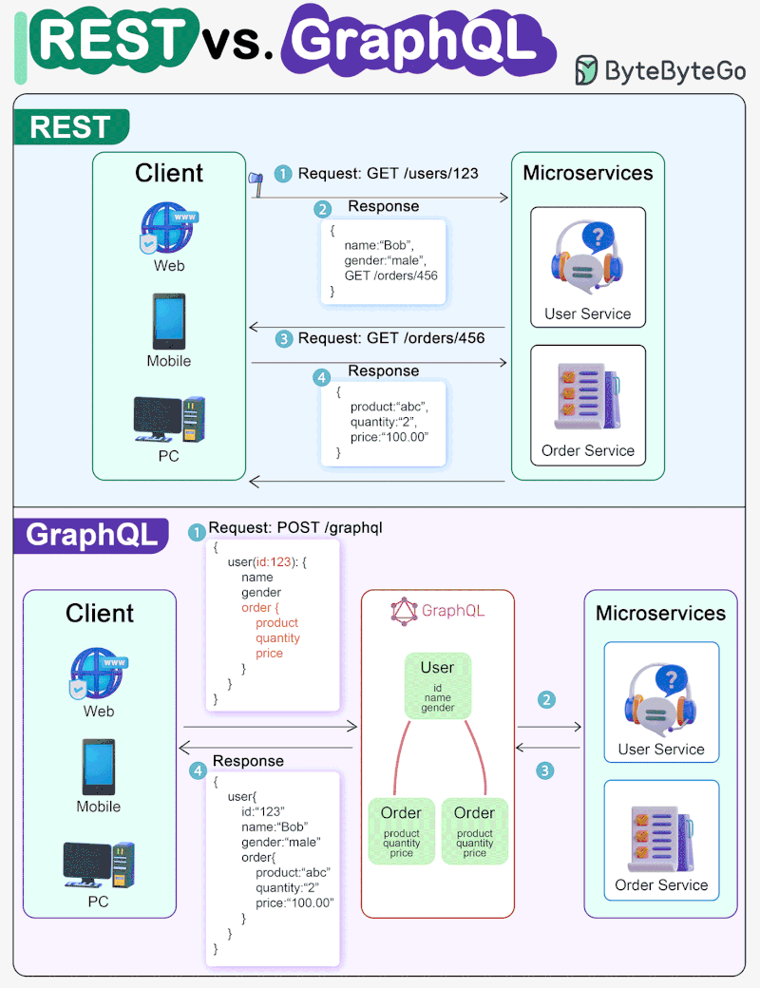
GraphQL vs. REST API
REST API
Each endpoint is responsible for a specific resource. Uses HTTP methods (GET, POST, PUT, DELETE).
Different data requires multiple queries to different endpoints.
Returns a fixed set of data, even if only a portion is needed.
Passes all endpoint data, even if the client only needs a few fields.
There is no hard typing, changes to the server can affect clients.
GraphQL
One endpoint for all requests, the client forms a request for his needs.
Several queries are combined into one, the data is selected selectively.
The client requests only those fields that are needed, without unnecessary data.
Passes only the requested fields, which reduces the amount of data.
A well-defined scheme with the verification of requests and responses.

Slide 31
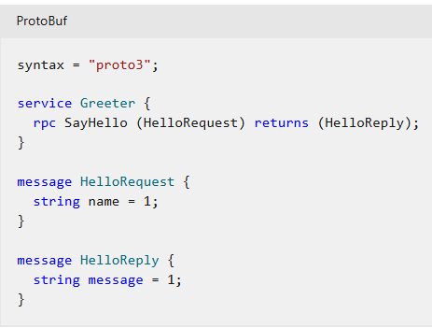
gRPC on .NET

Slide 32
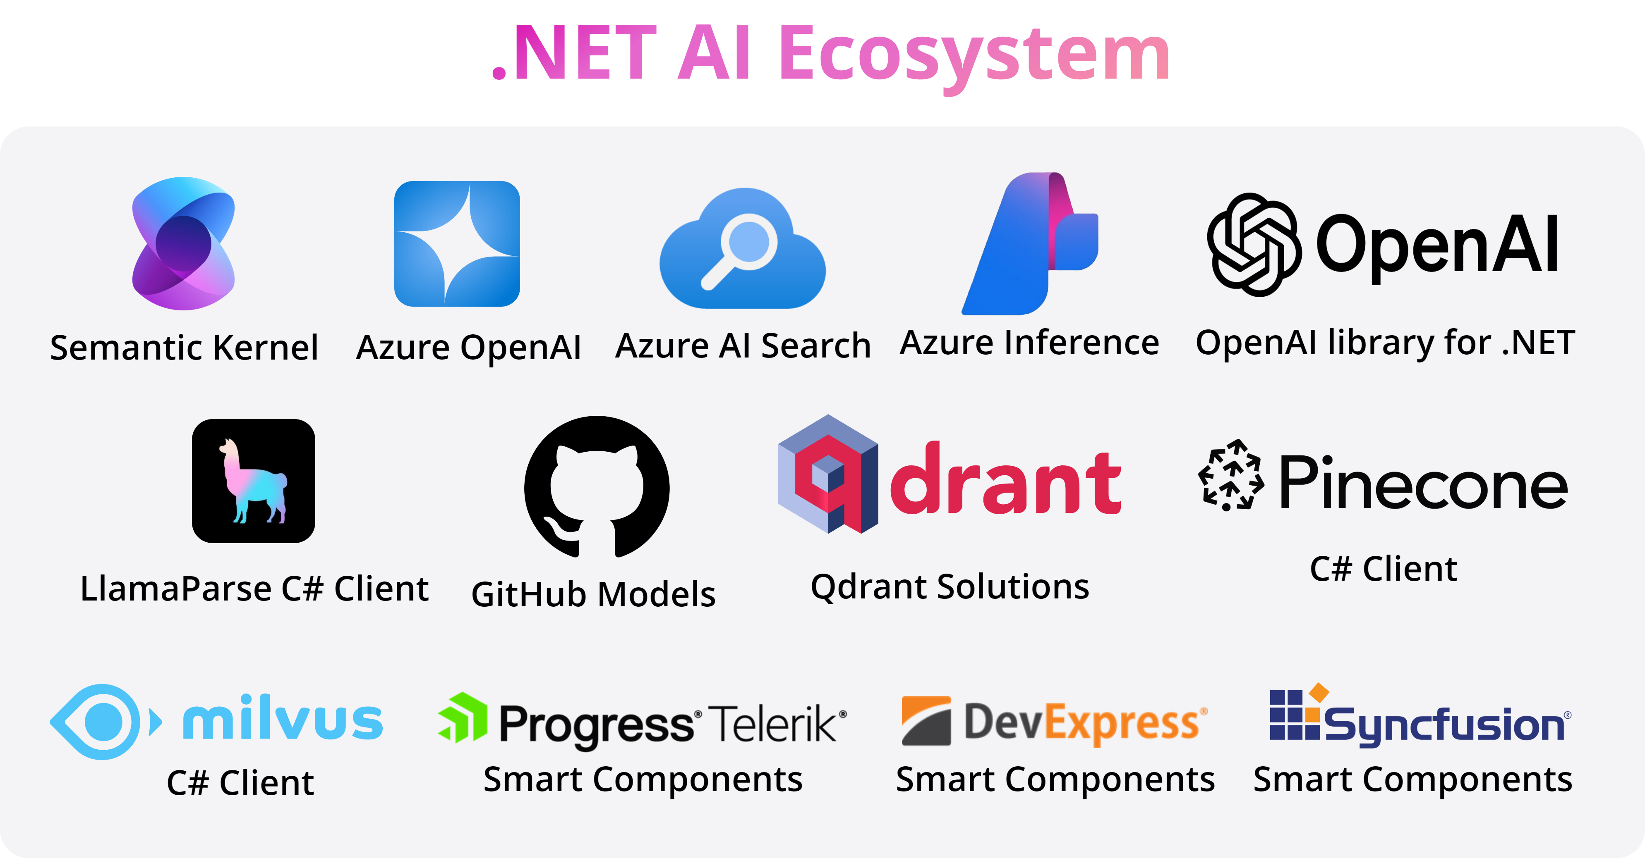
Artificial Intelligence and .NET

Slide 33
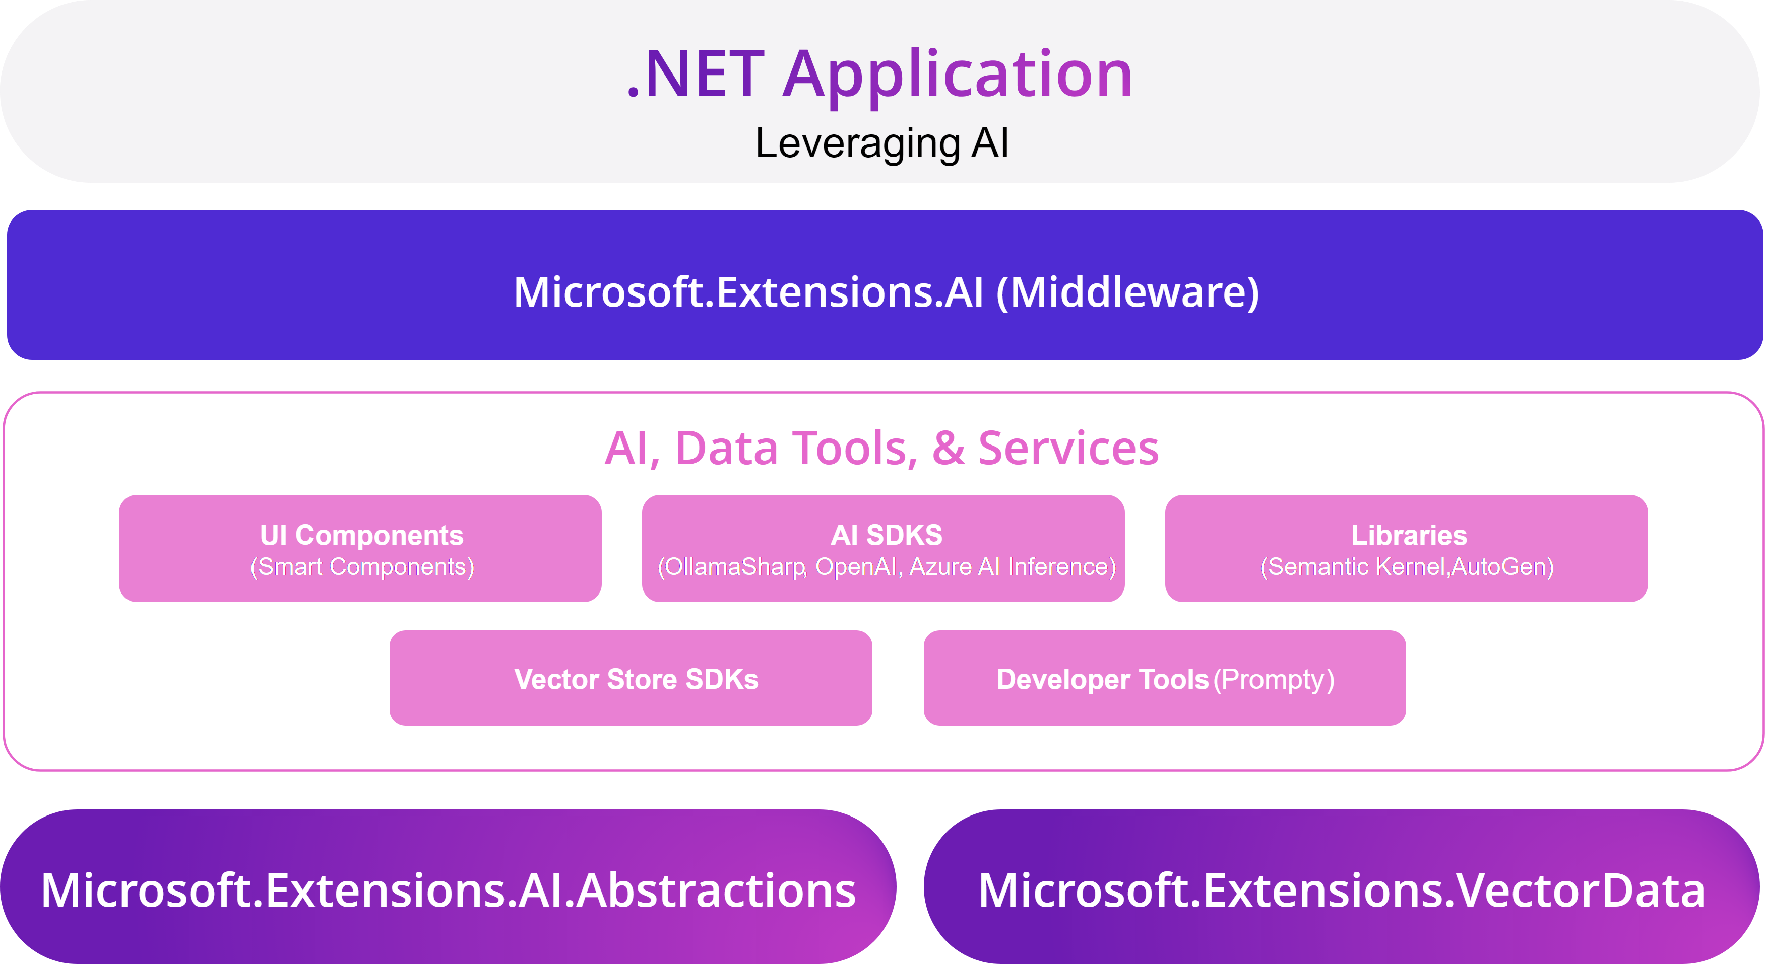
Artificial Intelligence and .NET

Slide 34
MCP, AI, .NET
Your computer
MCP Protocol
MCP Server A
Local
Data Source A
Internet
Host
(VS Code, IDEs)
Client
(GitHub Copilot)
MCP Server B
MCP Protocol
Web APIs
Local
Data Source B
MCP Protocol (SSE)
Remote
Remote Server
Web APIs
Remote
Service C
Notes:
MCP C# SDK

Slide 35
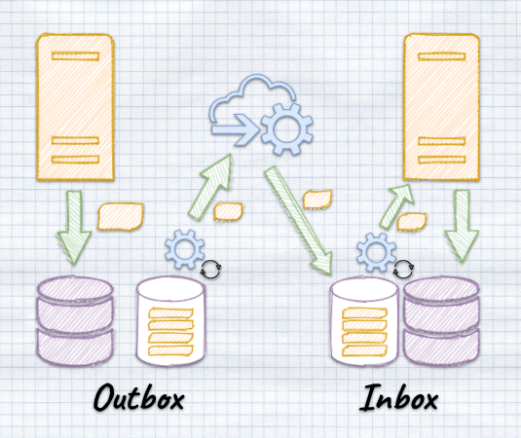
Inbox/Outbox Mechanisms

Slide 36
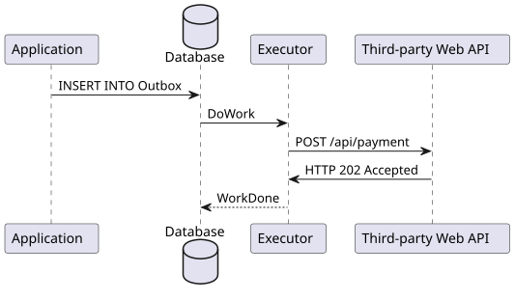
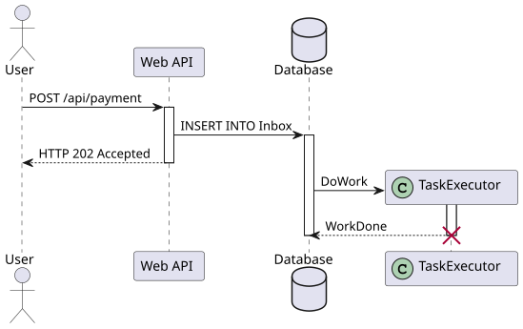
Inbox/Outbox Mechanisms
Outbox
Inbox
Ensures that the message has been successfully sent at least once.
Ensures that the message has been successfully received at least once.

Slide 37
Links and Samples
Modular Monolith Architecture
.NET 9 Overview
.NET Aspire docs
.NET AI Overview
Strawberry Shake Graph QL

